Slide 1
Presentation brief for MCT’s
Title of presentation | Monitoring Models
Presentation length | 120 minutes (including labs)
Audience | Data Scientists planning to operate machine learning workloads on Azure
Purpose | Describe how to monitor models with Application Insights Describe how to track data drift
(think) Student key takeaways | Monitoring model inferencing history helps improve the model and understand how the model is being used Data drift may be a significant factor in model performance degradation.
(feel) Student desired mindset | Confident configuring model monitoring Encouraged to track and address data drift
(do) Student outcomes | Monitor a deployed model with Application Insights Track data drift using datasets
More information | For course feedback, please use the MCT Forums

Slide 2

Module 10: Monitoring Models 因為資料變化

Slide 3
Agenda
Monitoring Models with Application Insights
Monitoring Data Drift 變更

Slide 4



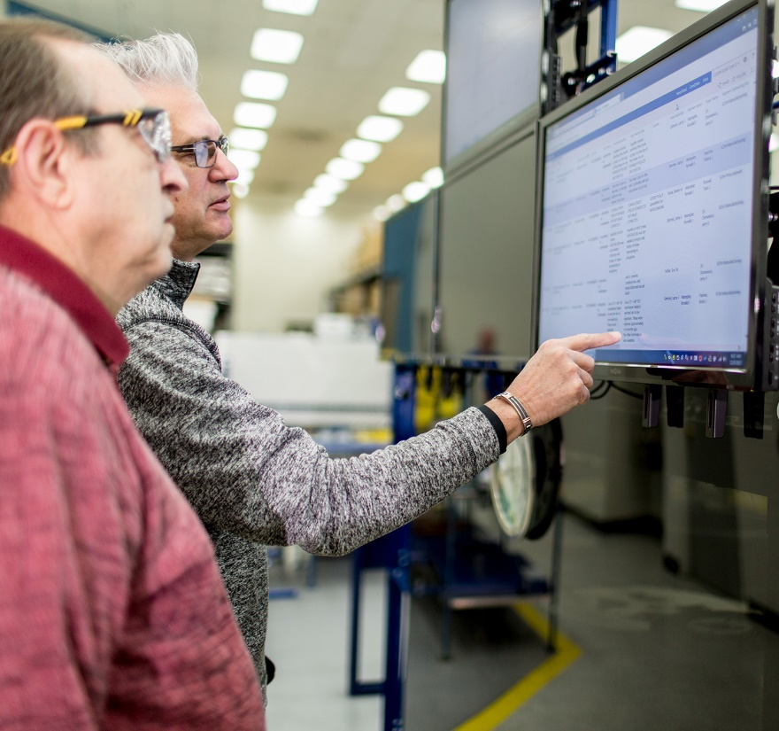






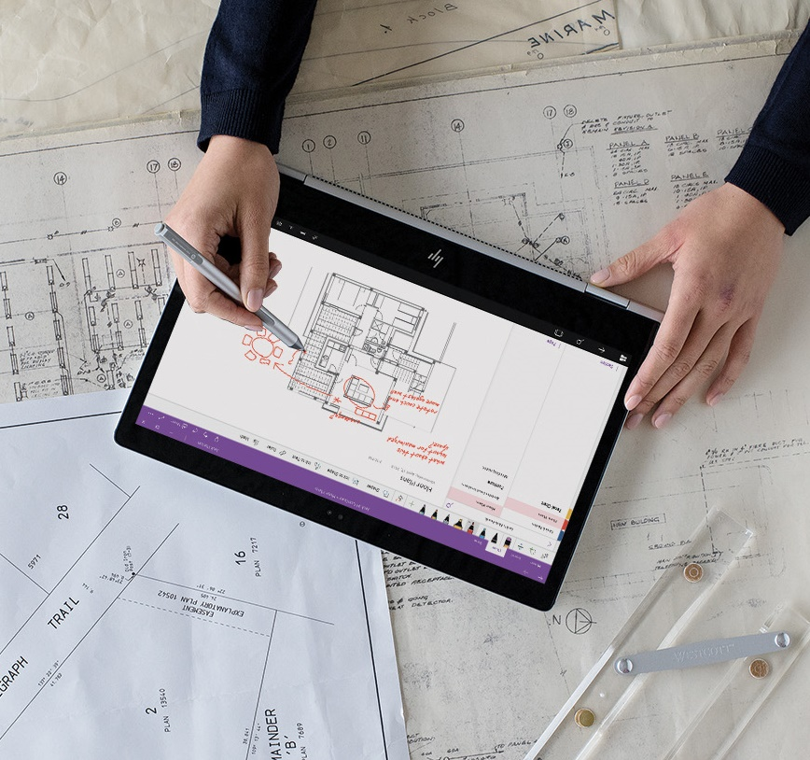


Lesson 1
Monitoring Models with Application Insights
Data
Cloud
AI

Slide 5





What is Application Insights?
An Application Performance Management service in Azure
Enables capture, storage, and analysis of telemetry data

Slide 6
Enabling Application Insights 模型被呼叫後的詳細記錄
Determine the Application Insights resource for your workspace
Enable in a new service deployment configuration using the SDK:
Enable for existing deployed services:
Configure AKS Deployment in the Azure portal
Update deployed service using the SDK
ws.get_details()['applicationInsights']
deploy_config = Webservice.deploy_configuration(enable_app_insights=True)
service.update(enable_app_insights=True)

Slide 7
Capturing and Viewing Application Insights Data
Print log data in the scoring script
Query Logs in Application Insights
def init():
model = joblib.load(Model.get_model_path('my_model'))
def run(raw_data):
data = json.loads(raw_data)['data']
predictions = model.predict(data)
log_txt = 'Data:' + str(data) + ' - Predictions:' + str(predictions)
print(log_txt)
traces
|where message == "STDOUT" and customDimensions.["Service Name"] = "my-svc"
| project timestamp, customDimensions.Content
timestamp | customDimensions_Content
01/02/2020, 9:11:57.846 PM | Data:[[1, 2, 2.5, 3.1], [0, 1, 1,7, 2.1]] - Predictions:[0 1]

Slide 8
Lab 10A
Monitoring a Model with Application Insights=詳細記錄
https://aka.ms/msl-dp100

Slide 9
Lesson Review
Complete the Review Questions

Slide 10
Lesson 2
Monitoring Data Drift 變更
Data
Cloud
AI

Slide 11








What is Data Drift?
Changing data trends that can affect the accuracy of trained models
Jan
y
Feb
y✗

Slide 12
Creating a Data Drift Monitor
Monitor by Comparing Datasets
Baseline dataset (original training data)
Target dataset for comparison over time (requires timestamp column)
Backfill to populate a data drift profile from target dataset
Monitor Service Inference Data
Include training dataset in model registration as baseline
Enable data collection for deployed model service
Run monitor to get data drift profile from scoring data
monitor = DataDriftDetector.create_from_datasets(ws, 'dataset-drift-detector',
baseline_data_set, target_data_set, ...)
backfill = monitor.backfill(dt.datetime.now() - dt.timedelta(days=30), dt.datetime.now())
model = Model.register(workspace=ws,model_path='./model/model.pkl', model_name='my_model',
datasets=[(Dataset.Scenario.TRAINING, train_ds)])
monitor = DataDriftDetector.create_from_model(ws, model.name, model.version, ...)
run = monitor.run(dt.datetime.now(), services, ...)

Slide 13
Data Drift Schedules and Alerts
On creation, specify:
Frequency
Drift threshold for alerting
Alert configuration
Schedule start (for model data drift monitors)
Data latency (for dataset data drift monitors)
alert_email AlertConfiguration('data_scientists@contoso.com')
monitor = DataDriftDetector.create_from_datasets(ws, 'dataset-drift-detector',
baseline_data_set, target_data_set,
compute_target=cpu_cluster,
frequency='Week', latency=2,
drift_threshold=.3,
alert_configuration=alert_email)

Slide 14
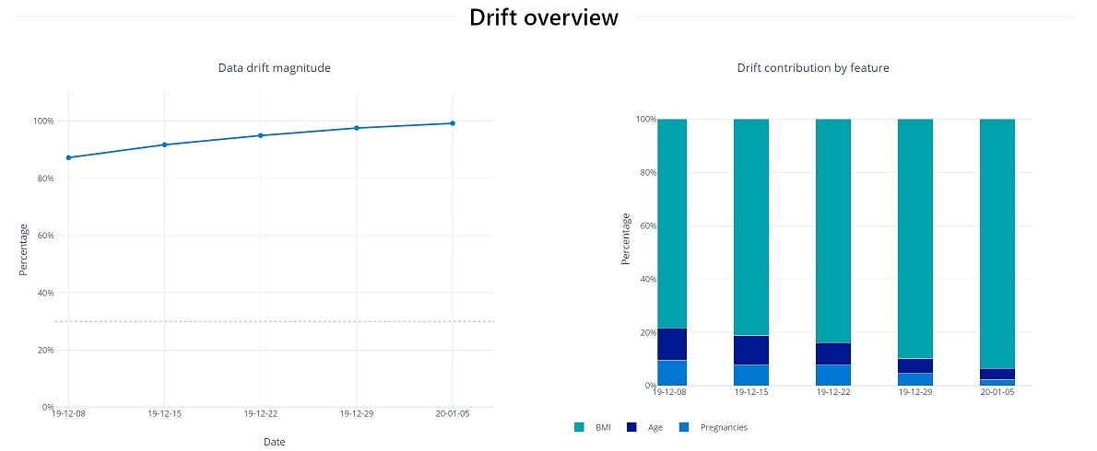
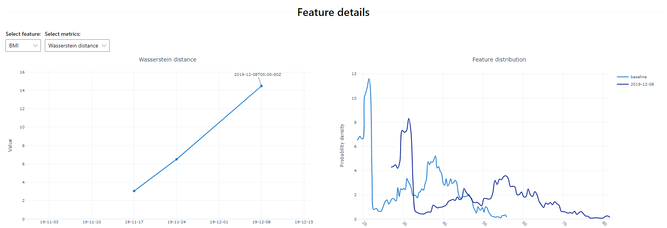
Reviewing Data Drift

Slide 15
Lab 10B
Monitoring Data Drift
https://aka.ms/msl-dp100

Slide 16
Lesson Review
Complete the Review Questions

